Slide 1
Lab 6: A Binomial Experiment
STAT 201: Elementary Statistics
As you enter room:
* Find your name on the sign in sheet.
Sign In by your Name
Find the Table you were randomly assigned.
** Sit at any of the seats and the table you were assigned.
Graded Lab Reports will be returned – keep these in case of an issue with the gradebook

Slide 2
Materials Needed for this lab
Each Table should have the following :
4 wooden skewers
Bucket of beads
A stopwatch

Slide 3
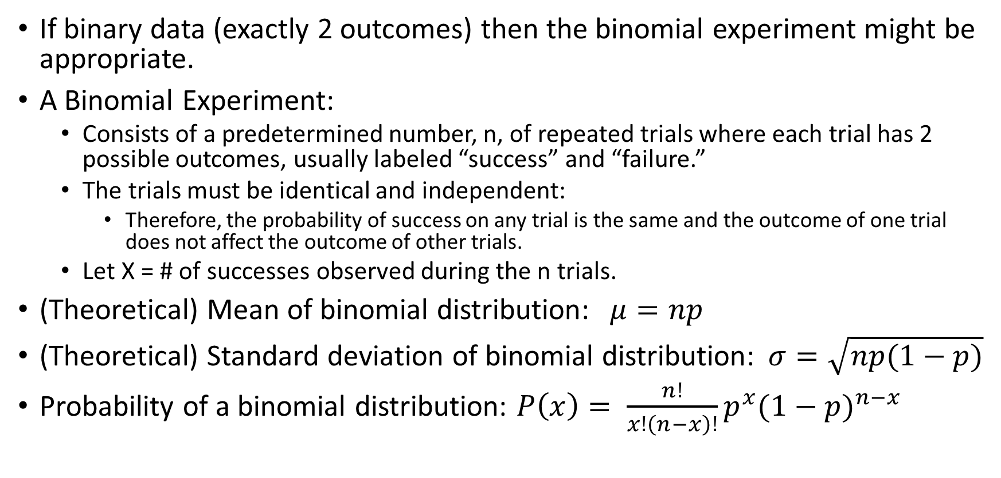
Concepts for this Lab : Binomial
If binary data (exactly 2 outcomes) then the binomial experiment might be appropriate.
A Binomial Experiment:
Consists of a predetermined number, n, of repeated trials where each trial has 2 possible outcomes, usually labeled “success” and “failure.”
The trials must be identical and independent:
Therefore, the probability of success on any trial is the same and the outcome of one trial does not affect the outcome of other trials.
Let X = # of successes observed during the n trials.
(Theoretical) Mean of binomial distribution:$μ=np$
(Theoretical) Standard deviation of binomial distribution:$σ=\sqrt{np(1−p)}$
Probability of a binomial distribution: $P\left(x\right)= \frac{n!}{x!\left(n−x\right)!}p^{x}{(1−p)}^{n−x}$

Slide 4
The Set up of the “Game”
The producers of a game show want 80% of competitors to be able to complete a task.
Assume our class represents a random sample (it doesn’t but we are assuming it does).
Each student will attempt the task.
Question: Based on the experiment, the producers would like to know if there is evidence that less than 80% will complete the task.

Slide 5
The Challenge (Data collection)
Each student will have 60 seconds to complete the task (I will keep time) and you have 3 attempts to successfully complete the task. Once you are successful you do not need to do the other attempts.
Setting up the skewer:
Hold the skewer vertically (placing fingers at the bottom so the beads don’t fall off). Pointed end of the skewer at top.
Place a uniquely colored bead on the skewer and then place 21 beads of another color on the skewer.
21 beads of the same color on top of a bead of a different color.
When I say go:
Remove the top bead and place it on the bottom of the skewer.
Keep moving the beads one at a time until the uniquely colored bead is on top or time is up.
When time is up count the number of beads you were able to move. (The number under your uniquely colored bead).
Record your number in table 6.1 page 47.
If you were successful in moving all beads (the uniquely colored bead was on top) then you are done, if not then we try again.

Slide 6
Each student needs to fill out the last two columns in table 6.1:
Maximum number of beads moved in any one attempt.
Outcome.
Class Results: each student must tell me the maximum number of beads moved and the outcome (success or failure).
Enter class results in Table 6.2 page 47.

Slide 7
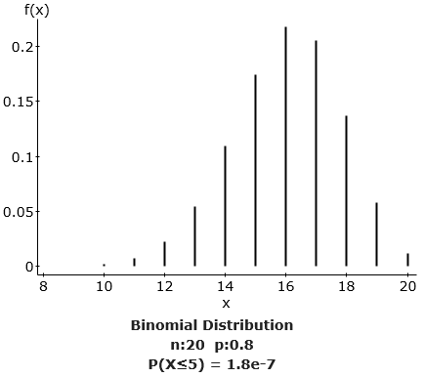
Histogram to answer questions (I will print one for each student).

Slide 8
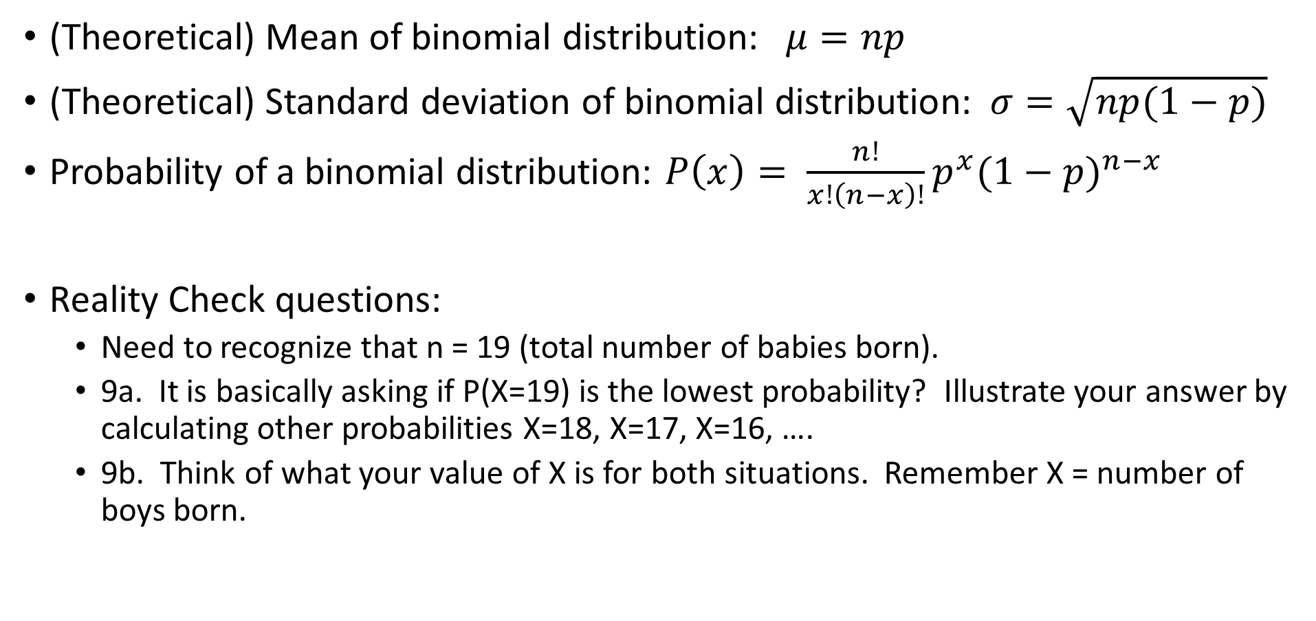
Question Reference:
(Theoretical) Mean of binomial distribution:$μ=np$
(Theoretical) Standard deviation of binomial distribution:$σ=\sqrt{np(1−p)}$
Probability of a binomial distribution: $P\left(x\right)= \frac{n!}{x!\left(n−x\right)!}p^{x}{(1−p)}^{n−x}$
Reality Check questions:
Need to recognize that n = 19 (total number of babies born).
9a. It is basically asking if P(X=19) is the lowest probability? Illustrate your answer by calculating other probabilities X=18, X=17, X=16, ….
9b. Think of what your value of X is for both situations. Remember X = number of boys born.

